Slide 1
Database Management System

Slide 2
Contents
Views
Triggers
Cursor

Slide 3
PL/SQL Constructs
PL/SQL is a combination of SQL along with the procedural features of programming languages. It was developed by Oracle Corporation in the early 90's to enhance the capabilities of SQL.
It is a block structured language that enables developers to combine the power of SQL with procedural statements. All the statements of blocks are passed to oracle engine all at once which increases processing speed and decreases the traffic.
DECLARE declaration statements;
BEGIN executable statements;
EXCEPTIONS exception handling statements;
END;

Slide 4
Differences between SQL and PL/SQL
SQL is a single query that is used to perform DML and DDL operations while PL/SQL is a block of codes, used to write the entire program blocks/ procedure/ function, etc.
SQL is declarative, that defines what need to be done, rather than how things need to be done while PL/SQL is procedural that defines how the things needs to be done.
SQL executes as a single statement while PL/SQL executes as a whole block.
SQL mainly used to manipulate data while PL/SQL mainly used to create an application.
SQL interact with a Database server while PL/SQL does not interact with the database server.
SQL cannot contain PL/SQL code in it while PL/SQL is an extension of SQL, so it can contain SQL inside it.

Slide 6
View
View is a data object which does not contain any data. Contents of the view are the resultant of a base table. They are operated just like base table but they don’t contain any data of their own. The programming concepts are very similar to MySQL.
The difference between a view and a table is that views are definitions built on top of other tables.
If data is changed in the underlying table, the same change is reflected in the view and vice-versa.
Advantages of Views are:-
To achieve logical data independence.
To improve data security
To preserves the appearance of original table structure.

Slide 7
Continue…
We can create a view for single table as well as for multiple table.
Types of Views :-
Simple View: These views can only contain a single base table or can be created only from one table. Group functions such as MAX(), COUNT(), etc., cannot be used here
Complex View: These views can contain more than one base table and they can contain a group by clause, join conditions, an order by clause.
Syntax:
CREATE <OR REPLACE> VIEW <ViewName>
AS SELECT <ColumnName1 >, <ColumnName2> FROM <TableName>
WHERE <Condition> ;

Slide 8
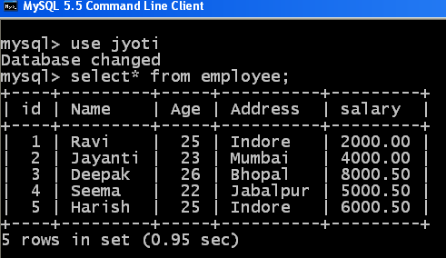
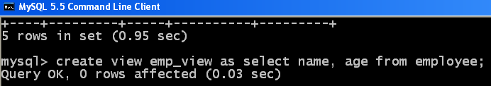
Example of Views
We are creating a view emp_view on employee table by the following query:

Slide 9
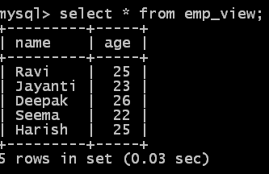
Queries applicable for Views
All the queries which are applicable for table, is also applicable for view like select, update, delete, drop etc.
If any modification done in view, it will be reflected in the base table also.

Slide 10
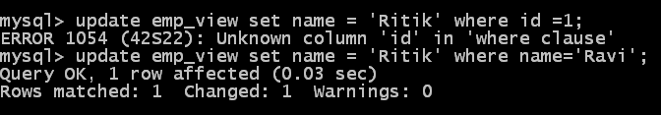
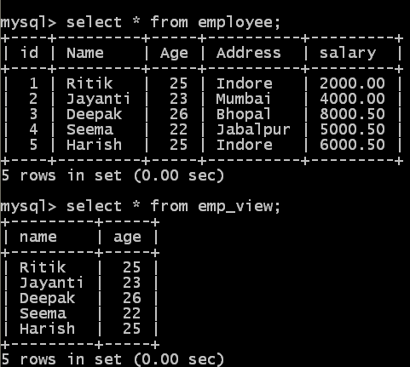
For updating the View we can use only those column name which are actually present in the View.

Slide 11
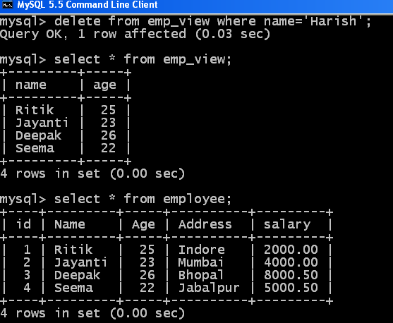
For deleting the View we can use only those column name which are actually present in the View.

Slide 12
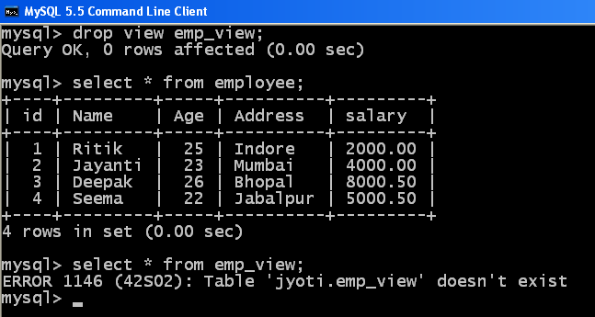
For dropping a View, we can use drop command. This command will not drop the underlying table.

Slide 13
View for multiple table
View from multiple tables can be created by simply include multiple tables in the SELECT statement.
create view region_sale1 as select l1.Region_name as Region, sum(s1.sales) as total_sale from location l1,store_info s1 where l1.store_Name=s1.store_name group by l1.region_name;

Slide 14
Triggers
Triggers are stored program which automatically fired when some events occur.
Triggers are written to be executed in response to any of the following events:
DML
DDL
Database Operations like Server Error, Log on , Log off, Startup or shut down.

Slide 15
Syntax for Triggers
CREATE [OR REPLACE ] TRIGGER trigger_name
{BEFORE | AFTER | INSTEAD OF }
{INSERT [OR] | UPDATE [OR] | DELETE}
[OF col_name] ON table_name
[REFERENCING OLD AS o NEW AS n]
[FOR EACH ROW]
WHEN (condition)
DECLARE
Declaration-statements
BEGIN
Executable-statements
EXCEPTION
Exception-handling-statements
END;

Slide 16
Continue…
CREATE [OR REPLACE] TRIGGER trigger_name − Creates or replaces an existing trigger with the trigger_name.
{BEFORE | AFTER | INSTEAD OF} − This specifies when the trigger will be executed. The INSTEAD OF clause is used for creating trigger on a view.
{INSERT [OR] | UPDATE [OR] | DELETE} − This specifies the DML operation.
[OF col_name] − This specifies the column name that will be updated.
[ON table_name] − This specifies the name of the table associated with the trigger.
[REFERENCING OLD AS o NEW AS n] − This allows you to refer new and old values for various DML statements, such as INSERT, UPDATE, and DELETE.
[FOR EACH ROW] − This specifies a row-level trigger, i.e., the trigger will be executed for each row being affected. Otherwise the trigger will execute just once when the SQL statement is executed, which is called a table level trigger.
WHEN (condition) − This provides a condition for rows for which the trigger would fire. This clause is valid only for row-level triggers.

Slide 17
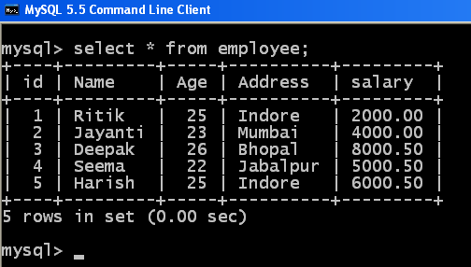
Example of Trigger
We are considering the same Employee table to understand the Trigger.

Slide 18
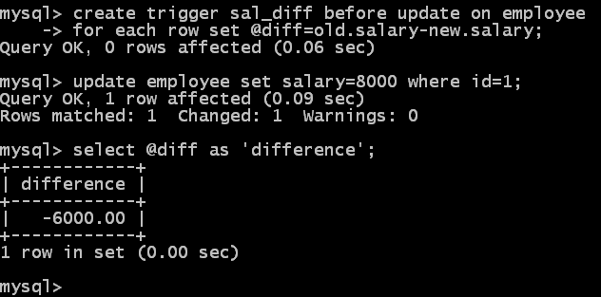
Example of Trigger

Slide 19
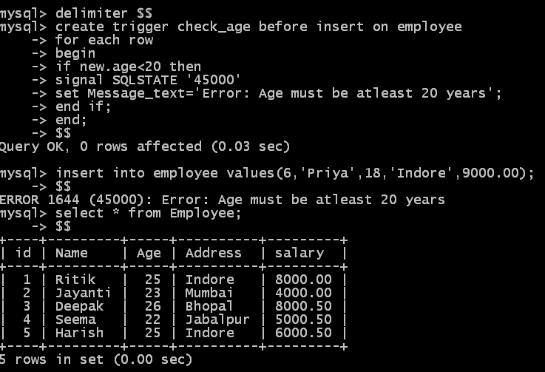
Write a trigger to ensure that no employee of age less than 20 can be inserted in the database.

Slide 20

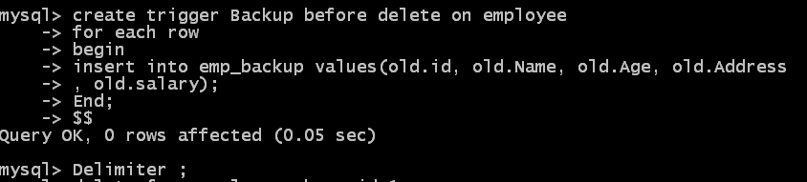
Create a trigger which will work before deletion in employee table and create a duplicate copy of the record in another table.
Before creating the Trigger we need to create one emp_backup table so that it holds the value of those employees who are no more the employee of the institution.

Slide 21
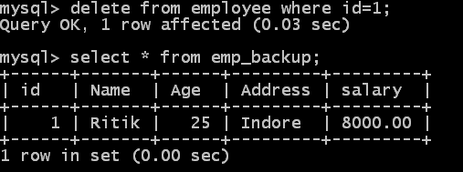
Continue…

Slide 22
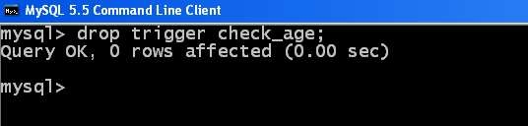
We can drop the trigger by using drop command.

Slide 23
Cursor
When an SQL statement is processed, Oracle creates a memory area known as context area. A cursor is a pointer to this context area. It contains all information needed for processing the statement.
In PL/SQL, the context area is controlled by Cursor. A cursor contains information on a select statement and the rows of data accessed by it.
A cursor can hold more than one row, but can process only one row at a time.
The set of rows the cursor holds is called the active set.

Slide 24
Properties Cursor
Read only
Non-scrollable
Asensitive

Slide 25
Types of Cursor
There are two types of cursors in PL/SQL:
Implicit cursor
Explicit cursor

Slide 26
Implicit Cursor
If the Oracle engine opened a cursor for its internal processing it is known as an Implicit Cursor. It is created “automatically” for the user by Oracle when a query is executed and is simpler to code.
Whenever a DML statement (INSERT, UPDATE and DELETE) is issued, an implicit cursor is associated with this statement.
For INSERT operations, the cursor holds the data that needs to be inserted.
For UPDATE and DELETE operations, the cursor identifies the rows that would be affected.

Slide 27
Mostly used attributes of Implicit Cursor
S.No | Attribute & Description
1. | %FOUND Returns TRUE if an INSERT, UPDATE, or DELETE statement affected one or more rows or a SELECT INTO statement returned one or more rows. Otherwise, it returns FALSE.
2 | %NOTFOUND The logical opposite of %FOUND. It returns TRUE if an INSERT, UPDATE, or DELETE statement affected no rows, or a SELECT INTO statement retur no rows. Otherwise, it returns FALSE.
3 | %ISOPEN Always returns FALSE for implicit cursors, because Oracle closes the SQL cursor automatically after executing its associated SQL statement.
4 | %ROWCOUNT Returns the number of rows affected by an INSERT, UPDATE, or DELETE statement, or returned by a SELECT INTO statement.

Slide 28
Explicit Cursor
Explicit cursors are programmer-defined cursors for gaining more control over the context area.
An explicit cursor should be defined in the declaration section of the PL/SQL Block. It is created on a SELECT Statement which returns more than one row.
There are four steps in Explicit Cursor.
DECLARE
OPEN
FETCH
CLOSE

Slide 29
Declaring the Cursor
Declaring the cursor defines the cursor with a name and the associated SELECT statement. For example −
Declare c_emp cursor for select Name, id, Address from employee [where id=4];

Slide 30
Opening the Cursor
Opening the cursor allocates the memory for the cursor and makes it ready for fetching the rows returned by the SQL statement into it. For example, we will open the above defined cursor as follows :-
OPEN c_emp;

Slide 31
Fetching the Cursor
Fetching the cursor involves accessing one row at a time. For example, we will fetch rows from the above-opened cursor as follows −
FETCH c_emp INTO c_id, c_name, c_addr;

Slide 32
Closing the Cursor
Closing the cursor means releasing the allocated memory. For example, we will close the above-opened cursor as follows −
CLOSE c_emp;

Slide 33
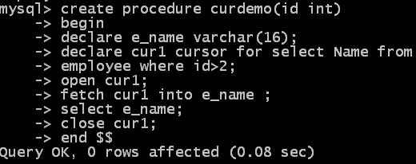
Complete example of Explicit Cursor

Slide 34
Thanks

